Slide 1
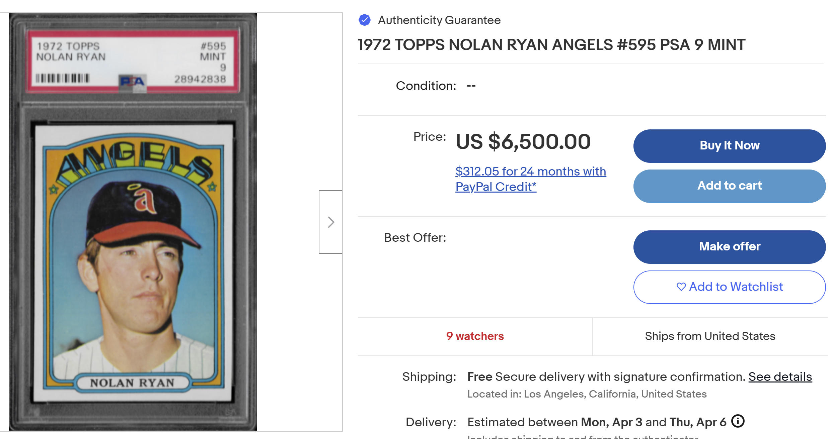
FINAL PROJECT IST 659
Baseball cards and player stats
3/28/2023
Team Name: TAKE ME OUT TO THE BALLPARK! Team Members: Andrew Alford, Ryan Summers, Bill Steel

Slide 2
Table Of Contents
Introduction and project approval
Conceptual and Logical data models
External data model and User Interface
Implementation: Table buildout and data migration
Implementation: Stored Procedure development based on Use Cases
Appendix
- Team Log of contributions
- Mapping of required artifacts from the syllabus

Slide 3
Introduction and project approval
Concept and Genesis
Our project centers around baseball cards and players. Specifically, Topps baseball cards between 1970 and 1989 as well as player information and statistics about those that played during this era. Baseball cards can be categorized in terms of “raw” cards and “graded” cards. Raw cards are the familiar unprotected cards that kids purchase at convenience stores. Graded cards have been formally examined by an authorized grading institution. A graded card gets encapsulated in a protective cover (as shown on the title page) and is formally registered with a unique certification number. In the case of this project, the grading institution is Professional Sports Authority (PSA) which is considered to be the most consistent and trusted grading agency for baseball cards. Cards are given a grade of 1-10 in half units with a 10 being the highest possible grade and most valuable cards. On January 14th, 2021, a PSA 9 1952 Topps Micky Mantle rookie card sold for $5.2MM (a PSA 10 does not exist)!
Our database has an inventory of almost 4000 graded cards from one of our team members (not including a PSA 9 1952 Topps Micky Mantle ☺) and also the inventory of ALL raw Topps cards from 1970-1989 (~15,000). Additionally, we have player statistics by year for all Major League baseball players over the same period as well as general player information about each (over 2500 players). This comprehensive set of data permits outstanding opportunities to discover information about players and/or cards during an exciting 20-year era of baseball! Our user interface permits user-friendly access into this database.

Slide 4
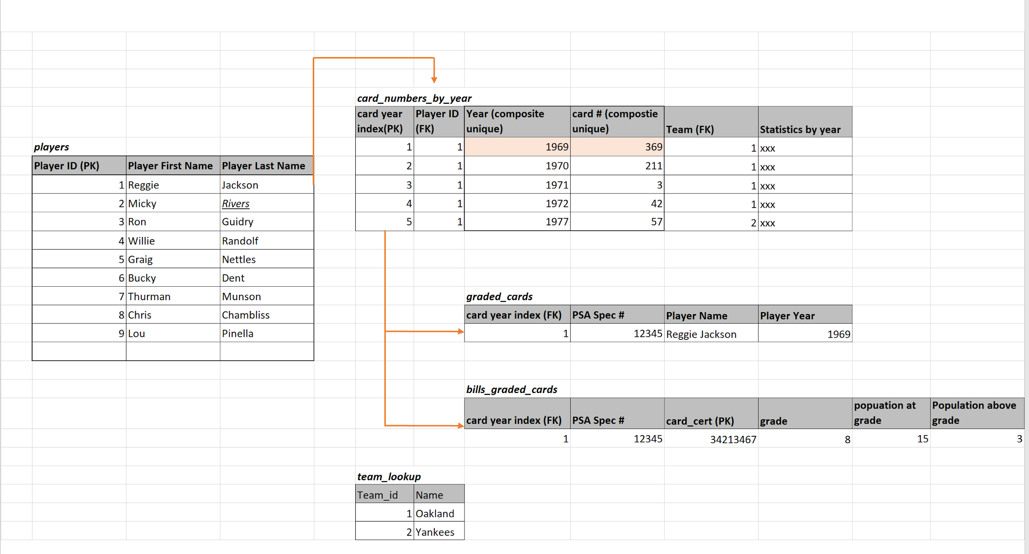
Introduction and project approval
Project Approval
On February 7th, we reviewed our concept and a rough E-R diagram with our professor. We were approved to proceed. The ERD has morphed into a conceptual data model and logical data model against which our database was implemented.

Slide 5
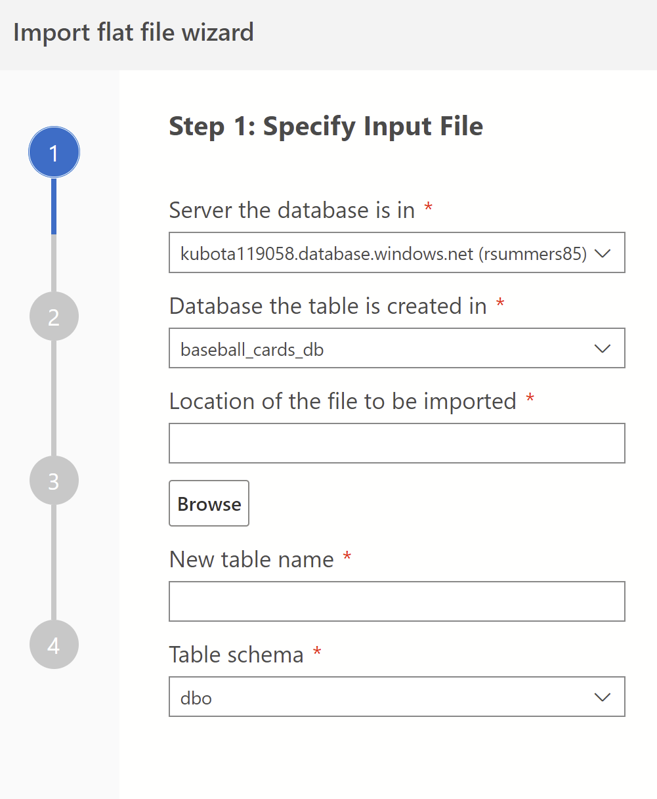
Introduction and project approval
Project Setup and Infrastructure
Our team successfully established a solid development infrastructure to support our project, leveraging the power of GitHub, Python, and SQL Server through Azure Portal. As a team of three developers, we collaborated to build a robust database to support the project's data management needs.
To ensure effective collaboration and version control, we chose GitHub as our main code repository, allowing us to work on the project simultaneously and efficiently manage changes and updates. In addition to GitHub, we also set up a SQL Server database, which serves as the backbone of our project. With the database, we were able to store, manage, and retrieve data with ease.
We met at least weekly to assess status against the artifact deliverables from the syllabus,
assign tasks and discuss issues that we were having.
As far as loading data, we leveraged 2 methods:
An extension with Azure called the “import wizard” which generates a table from a CSV file (shown to the right). After which, you alter the table to assign constraints (FK, Unique, etc.)
A python program written by one of our team members (Ryan Summers).

Slide 6
Introduction and project approval
Data migration and cleansing
Noteworthy for our project was the need for data migration/data cleansing as we were dealing with high volumes of data from different sources. While not listed within the artifacts of deliverables, we want to mention data migration/cleansing as a part of this report.
It was difficult.
Collecting data from various sources and marrying it to ensure referential integrity was a significant undertaking. That said, we believe this would be a common task during an actual implementation.

Slide 7
Table Of Contents
Introduction and project approval
Conceptual and Logical data models
External data model and User Interface
Implementation: Table buildout and data migration
Implementation: Stored Procedure development based on Use Cases
Appendix
- Team Log of contributions
- Mapping of required artifacts from the syllabus

Slide 8
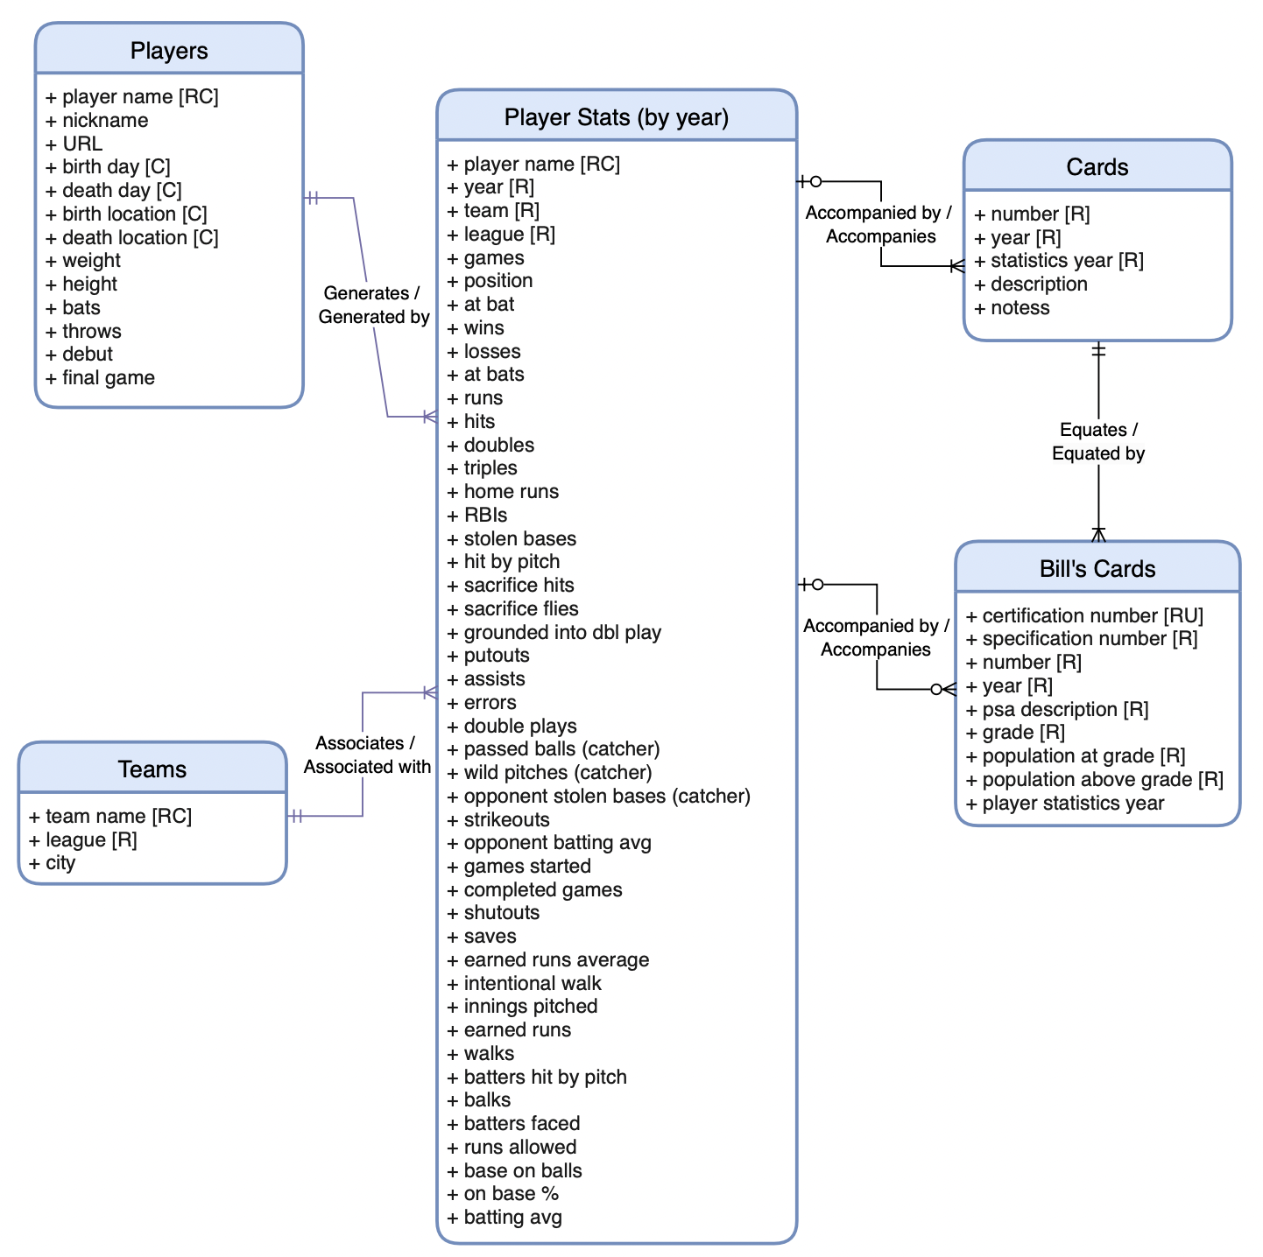
Conceptual data model
This conceptual model represents a database for baseball cards, with tables for Players, Player stats by year, Teams, Cards, and Bills cards. The Players table contains personal information about individual baseball players, while the Player stats by year table contains statistics on player performance in specific years. The Teams table represents the different baseball teams, and the Cards table contains information on the baseball cards that were produced between 1970 and 1989. Lastly, the Bill’s Card table represents cards owned by no other than Mr. Bill Steel. This table contains all relevant details about the card such as grade, population at/above grade, specification/certification number, and PSA descriptions.
Each player's performance in a given year is associated with a specific team, and each team can have one or many player stats. This is represented by a many-to-one relationship between the Player stats by year table and the Teams table. Additionally, each player can have multiple records in the Player stats by year table, with each record representing the player's performance in a specific year. This is represented by a one-to-many relationship between the Players table and the Player stats by year table
The Bills cards table represents the collection of baseball cards owned by a specific individual, and is related to the Cards table through a many-to-one relationship. This allows for tracking of ownership of specific cards in the overall population of baseball cards represented in the Cards table. Additionally, both Cards table can have zero or one player stat in a specific year. These are represented by a many-to-one relationship between Cards/Bills Cards and the Player stats by year table

Slide 9
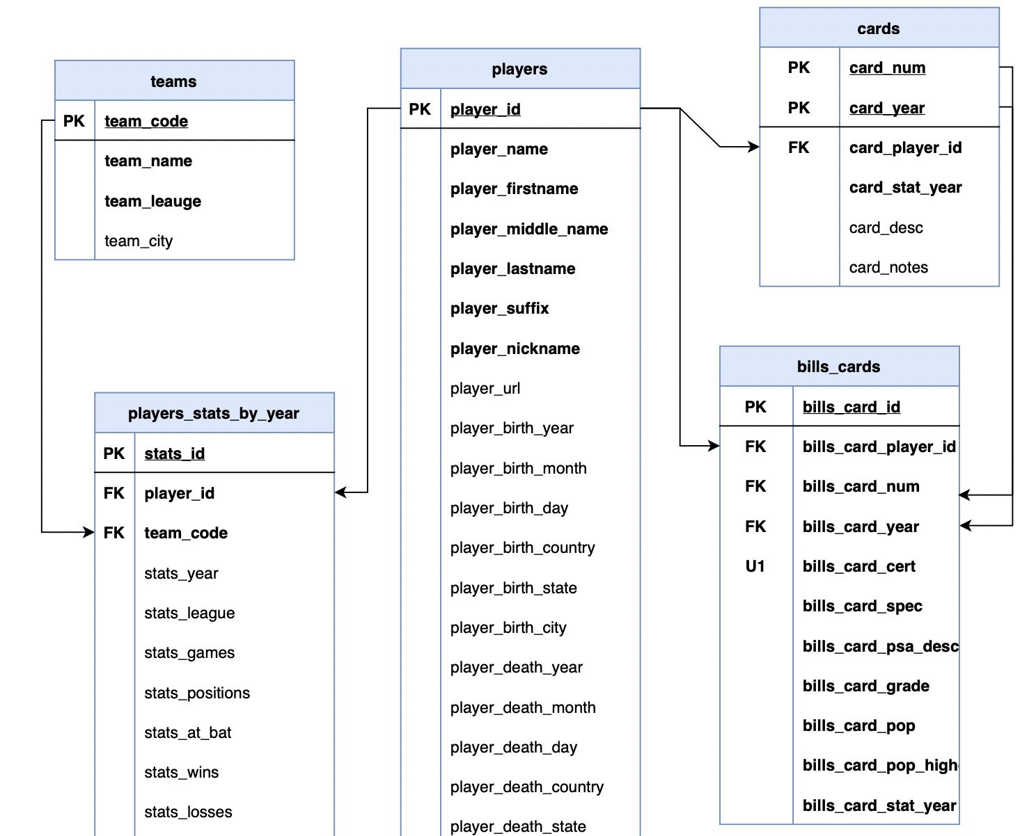
Logical data model
The logical model for this baseball card database includes five tables modeled from the conceptual model: Players, Player stats by year, Teams, Cards, and Bills cards.
The Teams table represents the different baseball teams, including team code and name, and is related to the Players stats by year table through a foreign key. Specifically, the Players stats by year table includes a foreign key to the Teams table, allowing each player to be associated with a specific team.
The Cards table contains information on the baseball cards that were produced between 1970 and 1989, including card number, player ID, year, and other relevant details. This table is related to the Players stats by year table through a foreign key, allowing each card to be associated with a specific player and their stats for that year.
The Bills cards table represents the collection of baseball cards owned by Bill Steel, including card number and other relevant details. This table is related to the Cards table through a foreign key, allowing each bill's card to be associated with a specific card in the overall population of baseball cards represented in the Cards table. Additionally, Bills Cards relates to the Player stats by year table in the same manner as the Cards table mentioned above.
Overall, this logical model provides a structured representation of the relevant entities and relationships within the baseball card domain, allowing for effective data management and analysis.

Slide 10
Table Of Contents
Introduction and project approval
Conceptual and Logical data models
External data model and User Interface
Implementation: Table buildout and data migration
Implementation: Stored Procedure development based on Use Cases
Appendix
- Team Log of contributions
- Mapping of required artifacts from the syllabus

Slide 11
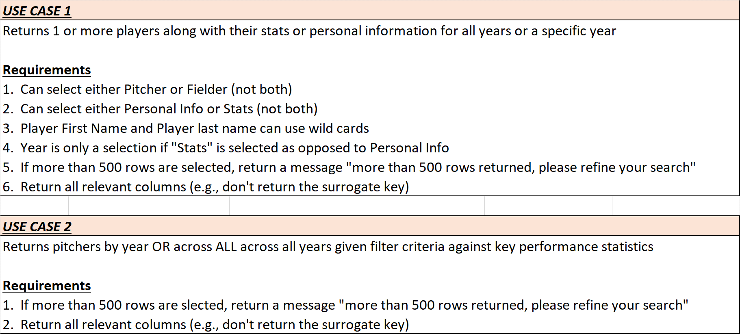
Identification of external data model and data logic
Our external data model is meant to give our users a view into the database. We designed an excel based user front end User Interface (UI) against a set of 5 main use cases to demonstrate the data model and data logic.

Slide 12
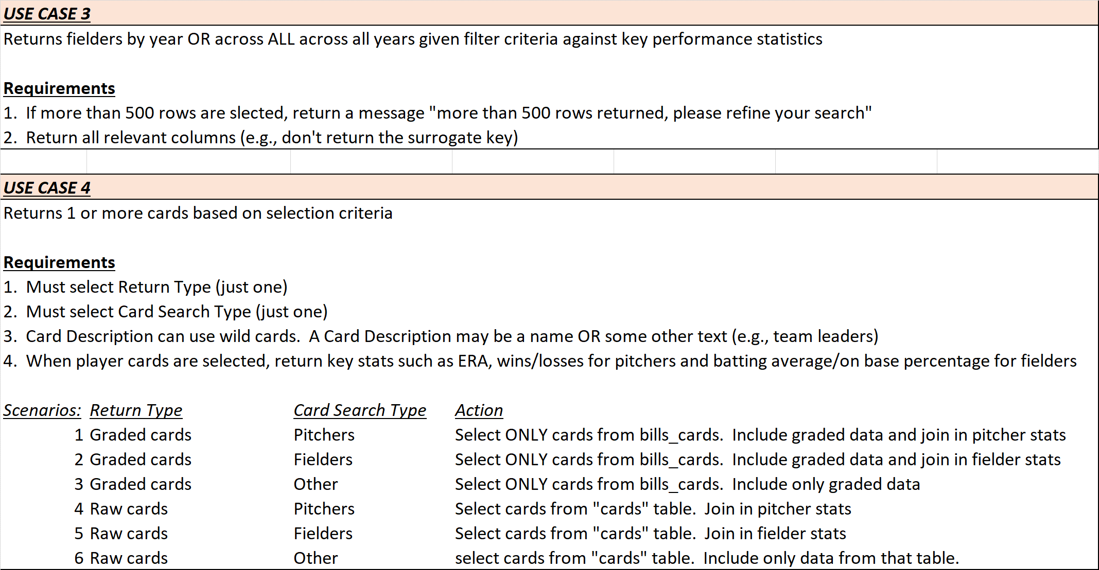
Identification of external data model and data logic
Our external data model is meant to give our users a view into the database. We designed an excel based user front end User Interface (UI) against a set of 5 main use cases to demonstrate the data model and data logic.

Slide 13
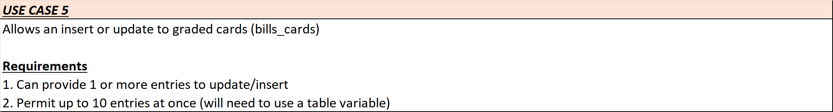
Identification of external data model and data logic
Our external data model is meant to give our users a view into the database. We designed an excel based user front end User Interface (UI) against a set of 5 main use cases to demonstrate the data model and data logic.

Slide 14
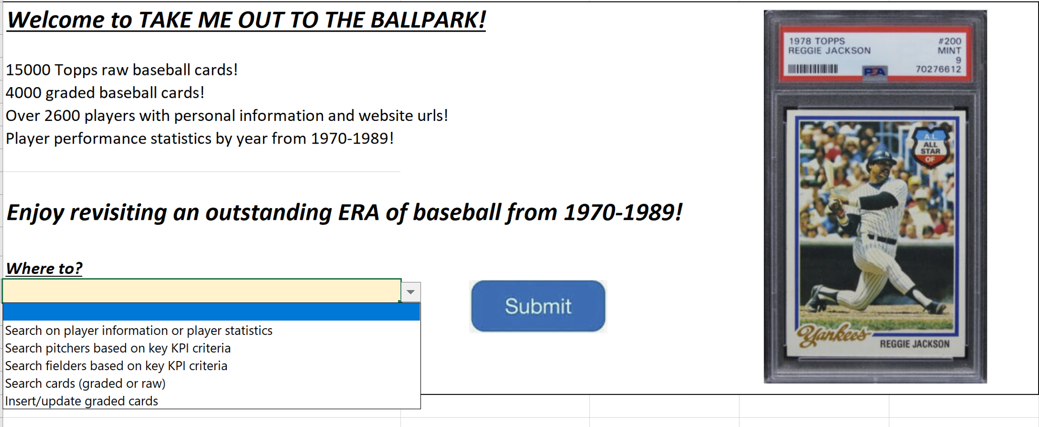
User Interface and application screens
Below is the entry screen into our application.

Slide 15
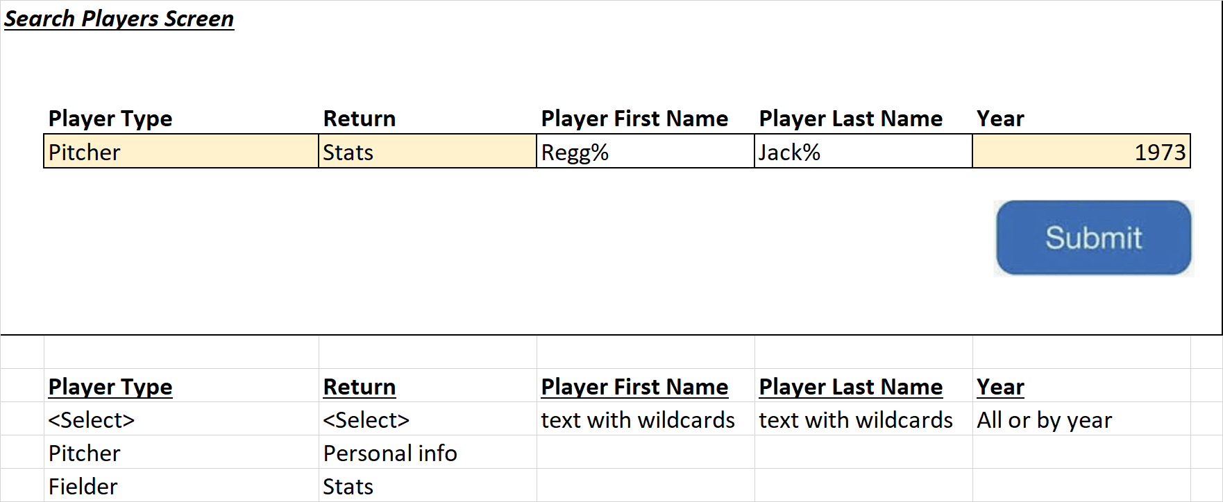
User Interface and application screens
Upon a user’s selection from the main screen, there are 5 specific application screens

Slide 16
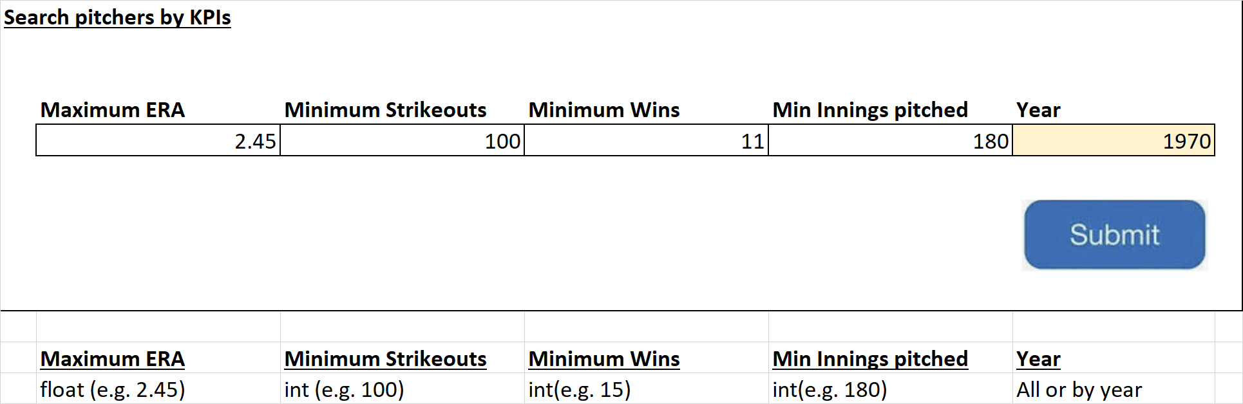
User Interface and application screens
Upon a user’s selection from the main screen, there are 5 specific application screens

Slide 17
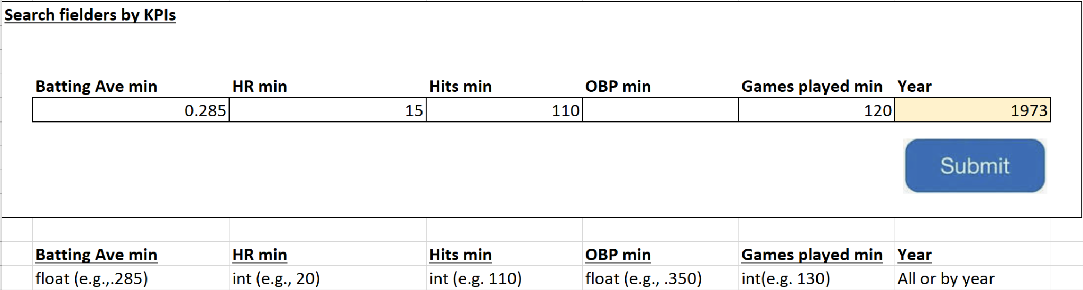
User Interface and application screens
Upon a user’s selection from the main screen, there are 5 specific application screens

Slide 18
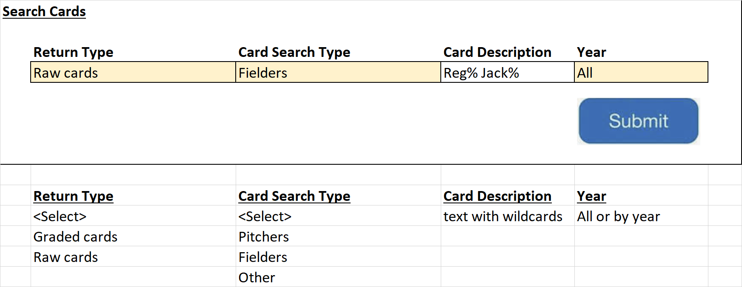
User Interface and application screens
Upon a user’s selection from the main screen, there are 5 specific application screens

Slide 19
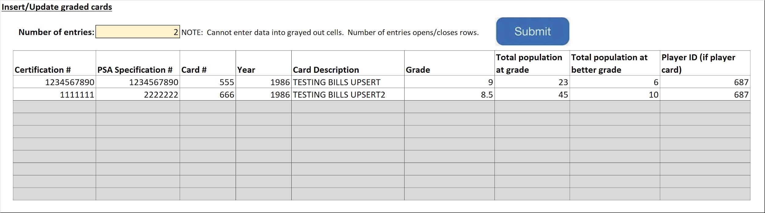
User Interface and application screens
Upon a user’s selection from the main screen, there are 5 specific application screens

Slide 20
Table Of Contents
Introduction and project approval
Conceptual and Logical data models
External data model and User Interface
Implementation: Table buildout and data migration
Implementation: Stored Procedure development based on Use Cases
Appendix
- Team Log of contributions
- Mapping of required artifacts from the syllabus

Slide 21

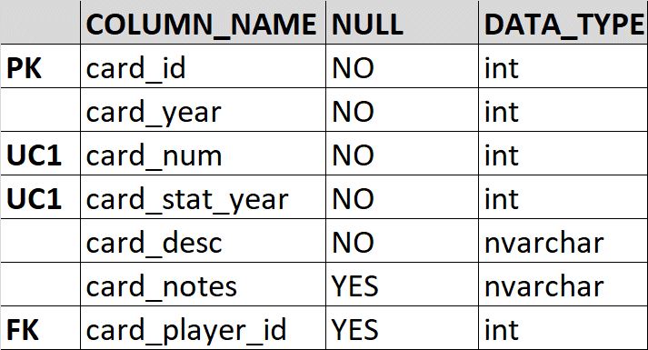
Table buildout and data migration
Based on the logical model, below shows the buildout of the “cards” table with the up/down SQL.
cards.csv
Azure import wizard
Up/down table creation sql code
cards table
drop table if exists cards
--TABLE CARDS...Loaded data into cards from a .csv using the Azure extension and then altered it to add an ID, PK, FK, and a composite unique constraint
Alter Table cards
Add card_id Int Identity(1, 1)
Alter Table cards
Add primary key (card_id)
ALTER TABLE cards
ADD CONSTRAINT uq_card_num_year UNIQUE(card_year, card_num);
Alter TABLE cards
ADD Foreign key (card_player_id)
references players(player_id)

Slide 22
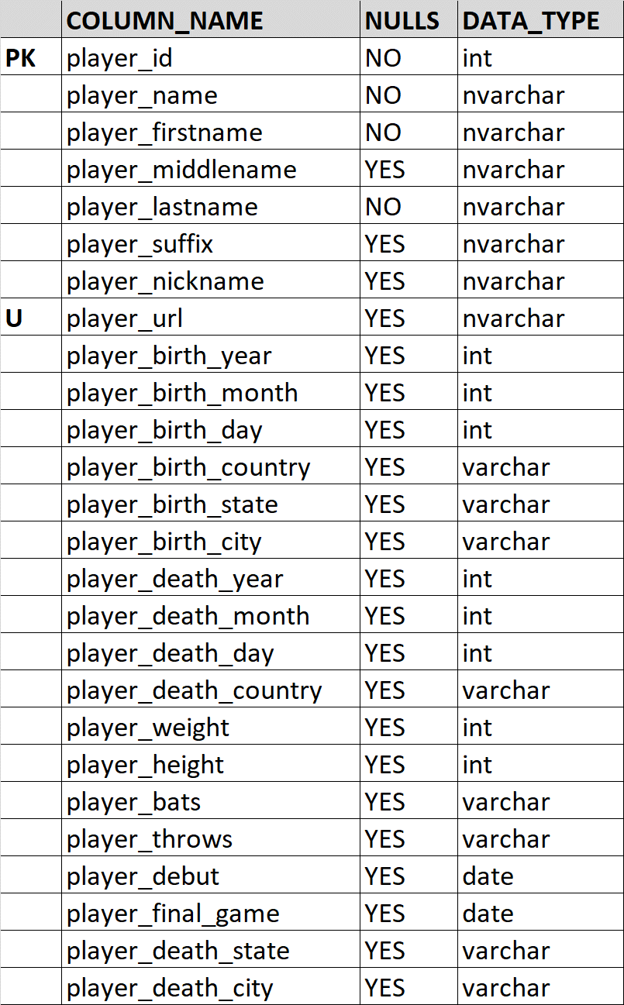
Table buildout and data migration
Based on the logical model, below shows the buildout of the “players” table with the up/down SQL.
players table
players.csv
Azure import wizard
Up/down table creation sql code
drop table if exists players
--TABLE PLAYERS...Loaded data into players from a .csv using the Azure extension and then altered it to add an ID and a PK
Alter Table players
Add player_id Int Identity(1, 1)
Alter Table players
Add primary key (player_id)
CREATE UNIQUE INDEX uq_player_url
ON players (player_url)
WHERE player_url IS NOT NULL

Slide 23
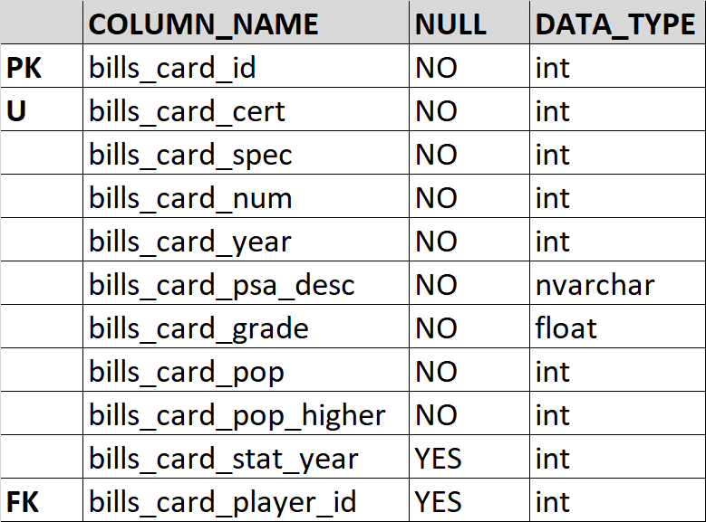
Table buildout and data migration
Based on the logical model, below shows the buildout of the “bills_cards” table with the up/down SQL.
Up/down table creation sql code
drop table if exists bills_cards
--TABLE BILLS_CARDS...Loaded data into bills_cards from a .csv using the Azure extension and then altered it to add an ID, PK, FK, and a unique constraint
Alter Table bills_cards
Add bills_card_id Int Identity(1, 1)
Alter Table bills_cards
Add primary key (bills_card_id)
ALTER TABLE bills_cards
ADD CONSTRAINT uq_bills_card_cert UNIQUE(bills_card_cert)
Alter TABLE bills_cards
ADD Foreign key (bills_card_player_id)
references players(player_id)
bills_cards.csv
Azure import wizard
bills_cards table

Slide 24
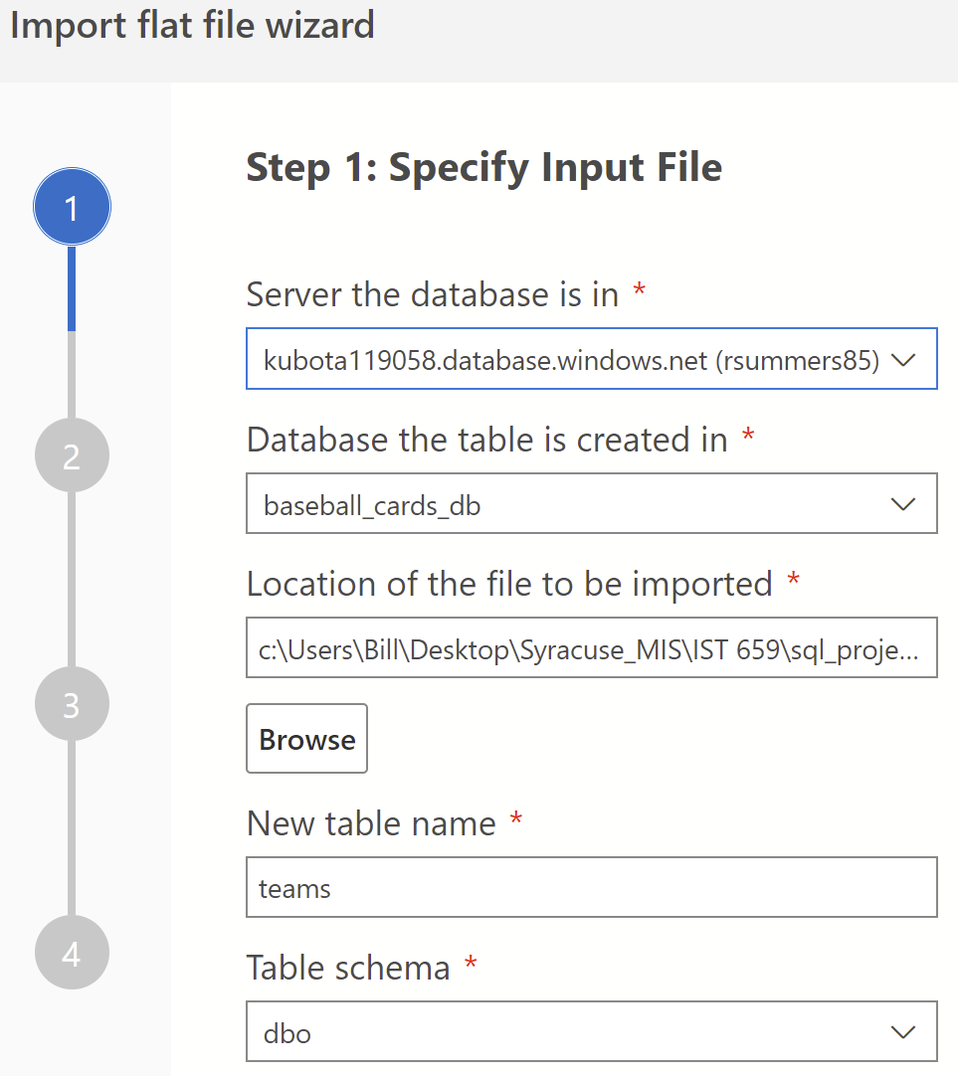
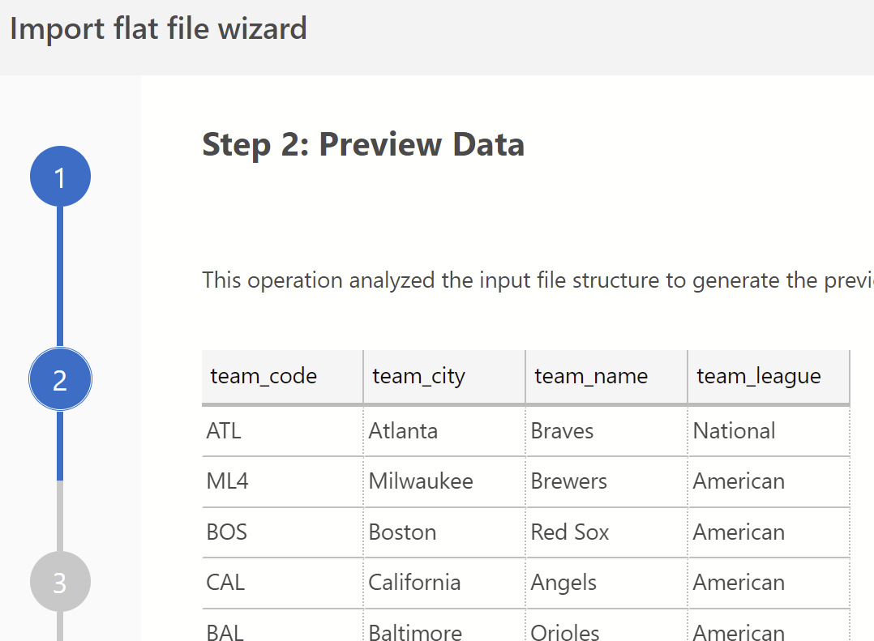
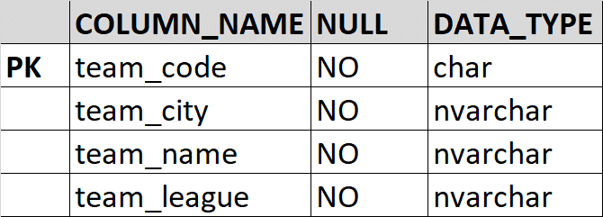
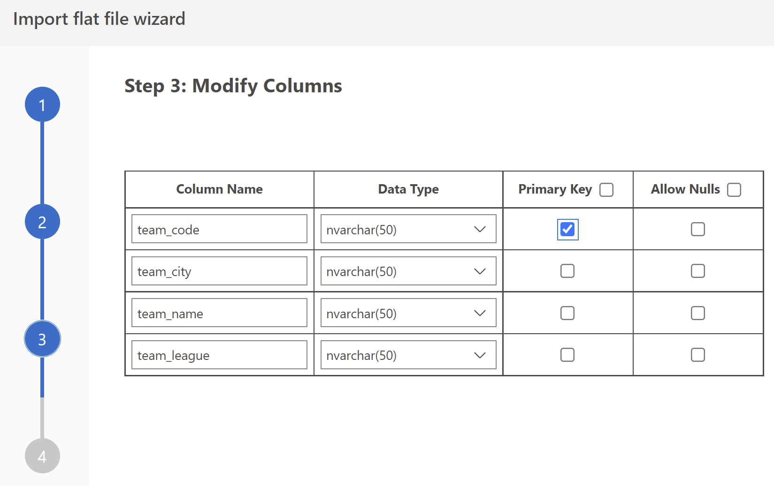
Table buildout and data migration
The “teams” table is a simple lookup table (28 teams). Azure Import Wizard permits the assignment of a primary key upon the migration and no other constraints were needed. Therefore, the only SQL needed was the “drop” code.
teams.csv
teams lookup table
down table sql code
drop table if exists teams
-- Loaded data into teams from a .csv using the Azure extension. No alterations needed.

Slide 25
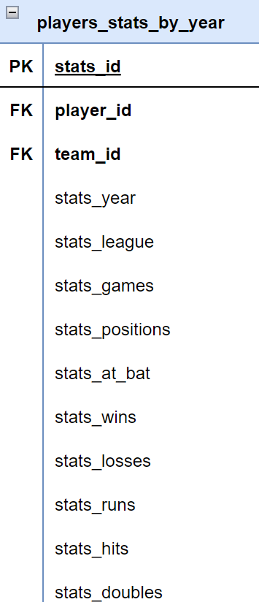
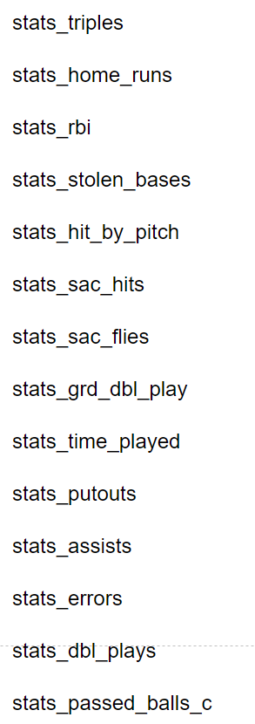
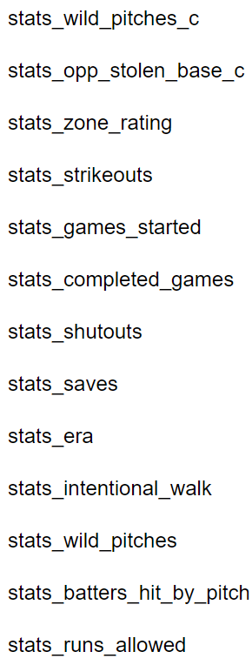
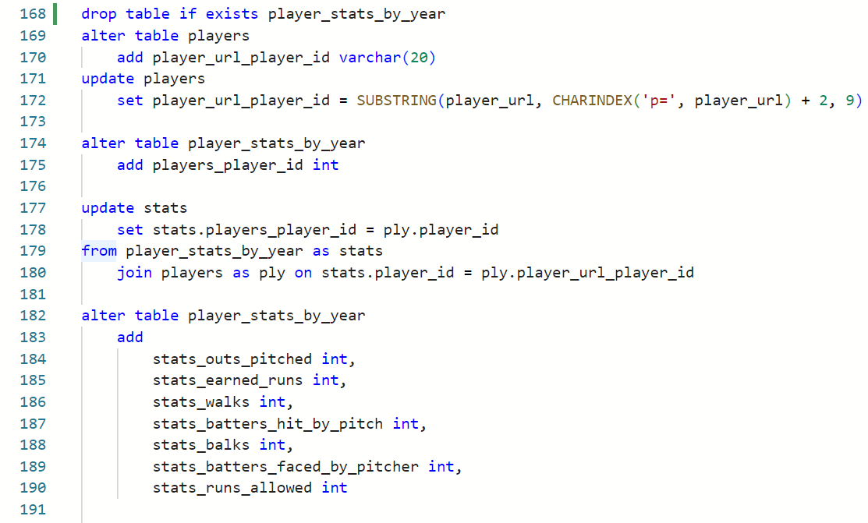
Table buildout and data migration
Based on the logical model, below shows the buildout of the “player_stats_by_year” table with the up/down SQL.
player_stats_by_year table
player_stats_by_year.csv
Up/down table creation sql code

Slide 26
Table buildout and data migration (Python Method)
Based on the logical model, below shows the Python code implementation of importing data from csv/.xlsx files into the database.
Establishes connection to DB
Executes SQL-DDL command within Python and imports data into DB. Closes connection to DB after statements are complete are complete
import pyodbc
import pandas as pd
import openpyxl
import sqlalchemy as sa
import urllib
import numpy as np
# establish connection to MSSQL DB
conn_str = (
r'DRIVER={ODBC Driver 18 for SQL Server};'
r'SERVER=KUBOTA_SERVER_NAME;'
r'DATABASE=baseball_cards_db;'
r'UID=USERID;'
r'PWD=PWD;')
cnxn = pyodbc.connect(conn_str)
cursor = cnxn.cursor()
cards.csv
for row in df.itertuples():
cursor.execute('''
insert into TABLE_NAME (
TABLE_ATTRIBUTES
)
values (?,?,?,?,?)
''',
row.SPREADSHEET_COLUMN_NAME,
)
cnxn.commit()
# close connection to server
cnxn.close()
Create DF from excel file
# create df from excel
df = pd.read_excel(‘FILE LOCATION’)

Slide 27
Table Of Contents
Introduction and project approval
Conceptual and Logical data models
External data model and User Interface
Implementation: Table buildout and data migration
Implementation: Stored Procedure development based on Use Cases
Appendix
- Team Log of contributions
- Mapping of required artifacts from the syllabus

Slide 28
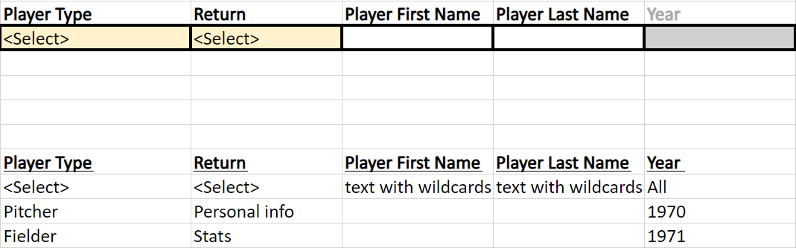
Stored Procedure development based on Use Case #1
USE CASE 1: Returns one or more players along with their professional stats or personal information for all years or a specific year.
The user interface below accepts user input for player types (pitchers or fielders), return (personal or professional stats), player first name, player last name, and year. Player first name, player last name, and year are all optional fields.

Slide 29
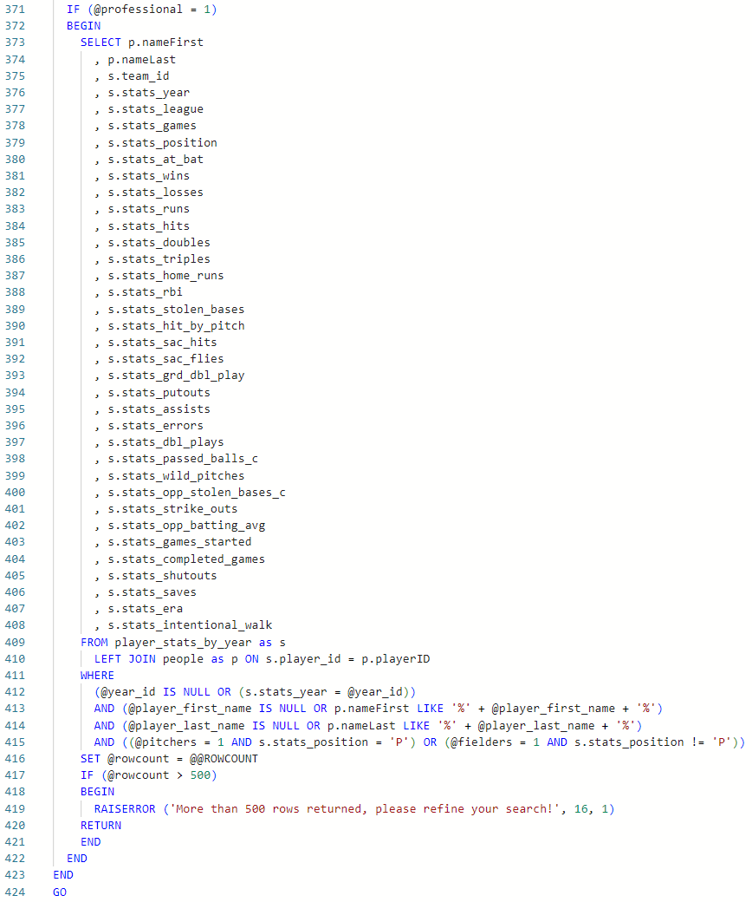
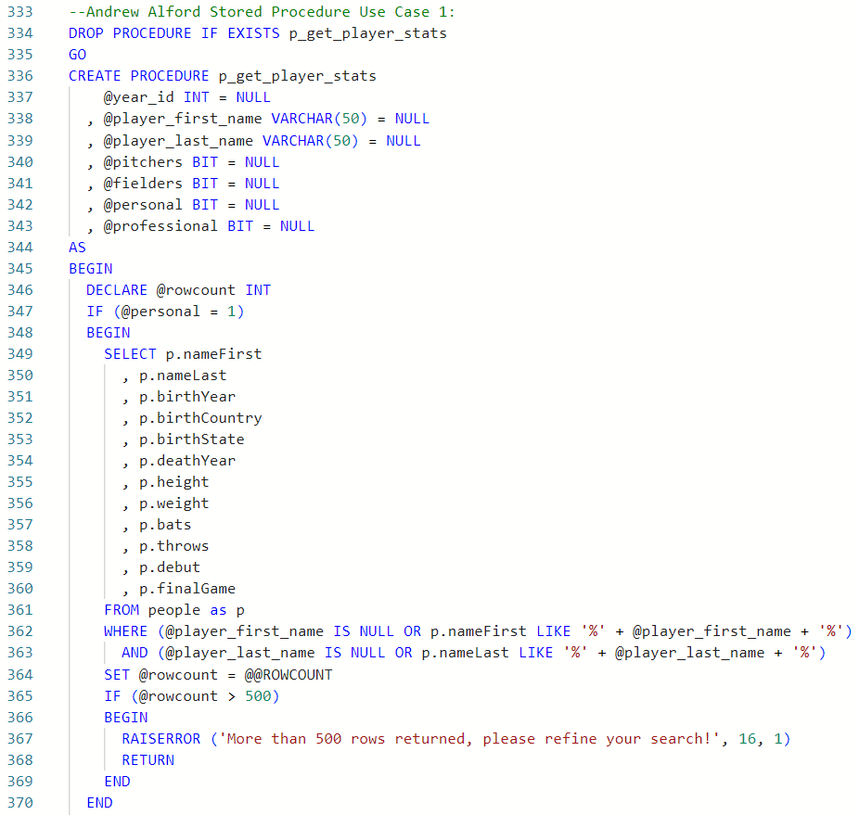
Stored Procedure development based on Use Case #1
SQL code for stored procedure p_get_player_stats:
Code Part 2:
Code Part 1:

Slide 30
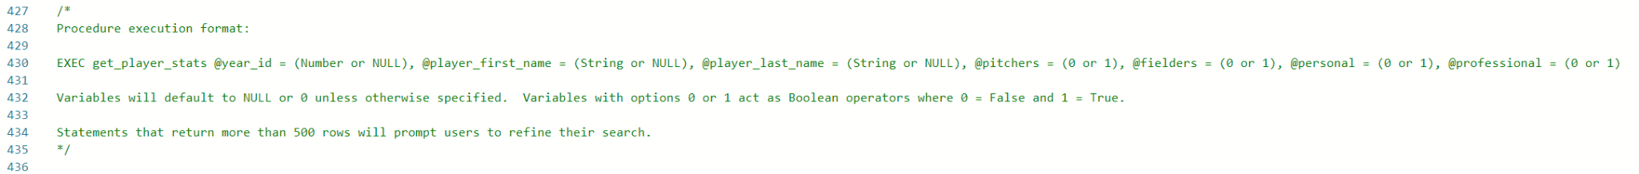
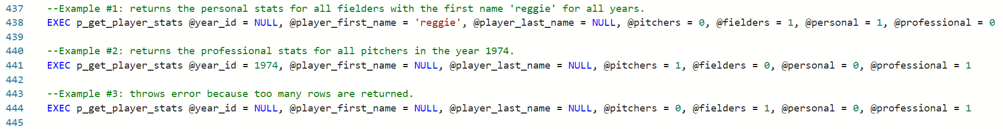
Stored Procedure examples based on Use Case #1
Shown below are some instructions on how to use the stored procedure and some example executions:
Use instructions
Example Executions

Slide 31
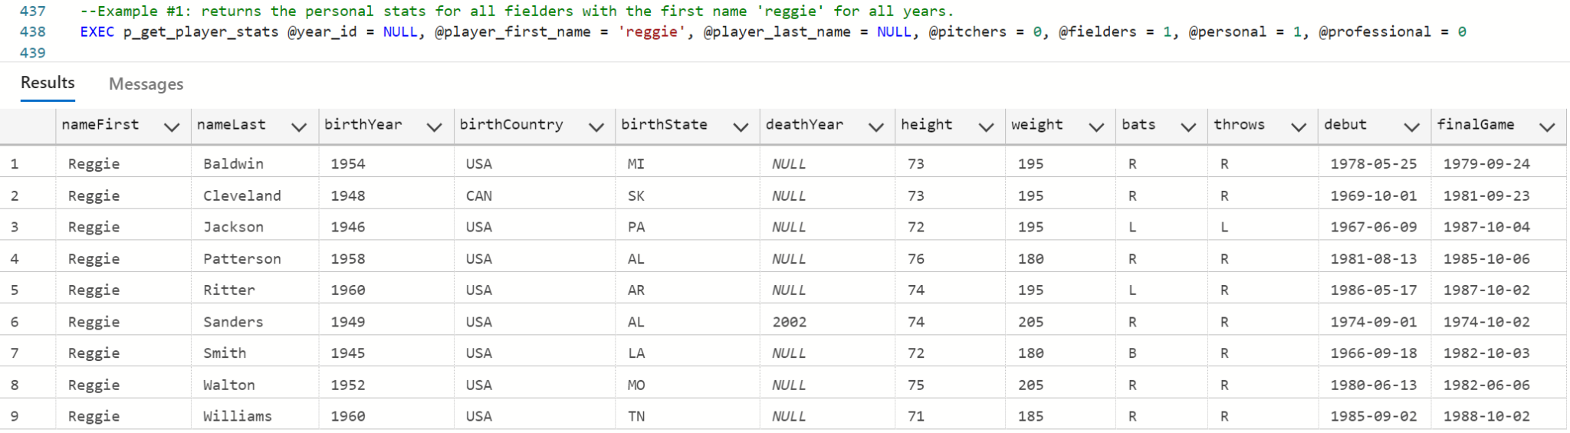
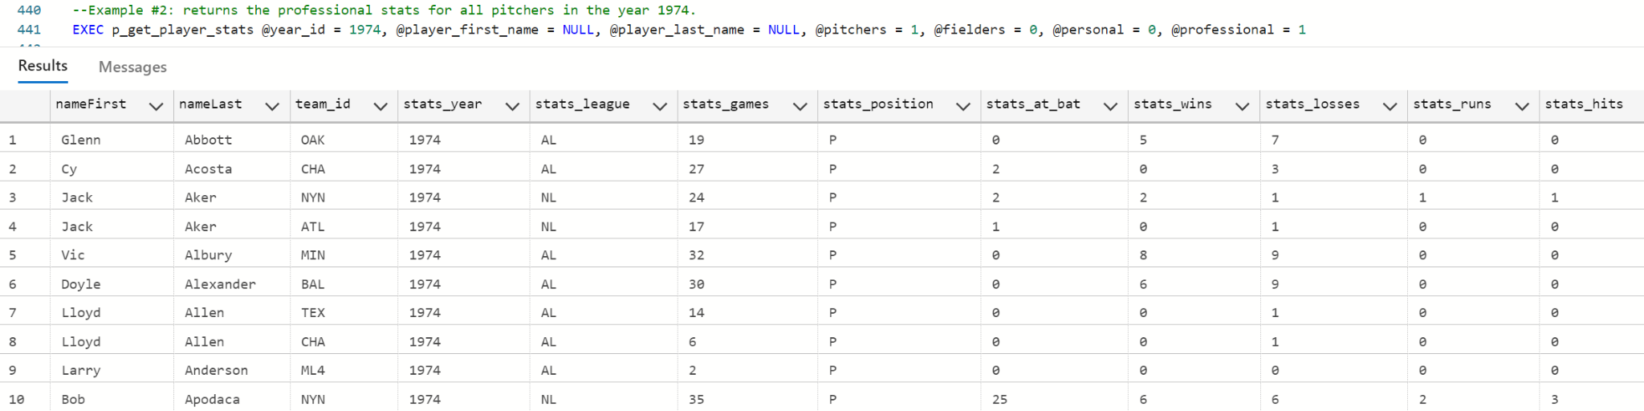
Stored Procedure examples based on Use Case #1
Shown below are the outputs of the examples given above:
Example 1 Output:
Example 2 Output:

Slide 32
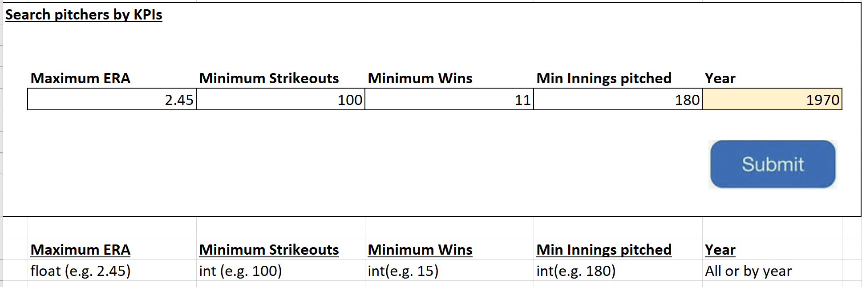
Stored Procedure development based on Use Case #2
USE CASE 2: Returns pitcher statistics based on selection criteria
The user interface below accepts user input for pitchers stats and has a drop down for years

Slide 33
Stored Procedure development based on Use Case #2
SQL code for stored procedure p_get_pitcher_stats:
1. Up/down SQL
drop procedure if exists p_get_pitcher_stats
GO
2. Pitcher’s Stats Procedure
create procedure p_get_pitcher_stats
@year int = NULL,
@max_era float = null,
@min_strk_out int = null,
@min_wins int = null,
@min_inns_pitched int = null
AS BEGIN set nocount on
DECLARE @num_rows INT SELECT @num_rows = COUNT(*)
FROM players AS p
INNER JOIN player_stats_by_year AS s ON p.player_id =s.players_player_id
WHERE s.stats_position = 'P'
AND (@year IS NULL OR s.stats_year = @year)
AND (@max_era IS NULL OR s.stats_era <= @max_era)
AND (@min_strk_out IS NULL OR s.stats_strike_outs >=@min_strk_out)
AND (@min_wins IS NULL OR s.stats_wins >= @min_wins)
AND (@min_inns_pitched IS NULL OR s.stats_outs_pitched >=@min_inns_pitched)
IF (@num_rows > 500)
RAISERROR('More than 500 rows returned, please refine your search.', 16, 1)
select p.player_firstname, p.player_lastname,
p.player_nickname, p.player_url,
s.stats_era, s.stats_strike_outs, s.stats_wins,
s.stats_outs_pitched,s.stats_year
from players as p
inner join player_stats_by_year as s
on p.player_id = s.players_player_id
where s.stats_position = 'P'
and (@year is null or s.stats_year = @year)
and (@max_era is null or s.stats_era <= @max_era)
and (@min_strk_out is null or s.stats_strike_outs >=@min_strk_out)
and (@min_wins is null or s.stats_wins >= @min_wins)
and (@min_inns_pitched is null or s.stats_outs_pitched >=@min_inns_pitched)
order by s.stats_era, s.stats_strike_outs desc, s.stats_wins desc, s.stats_outs_pitched desc
END
GO

Slide 34
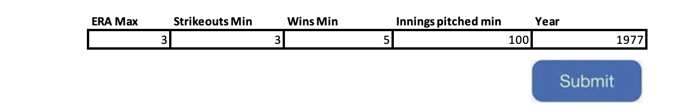
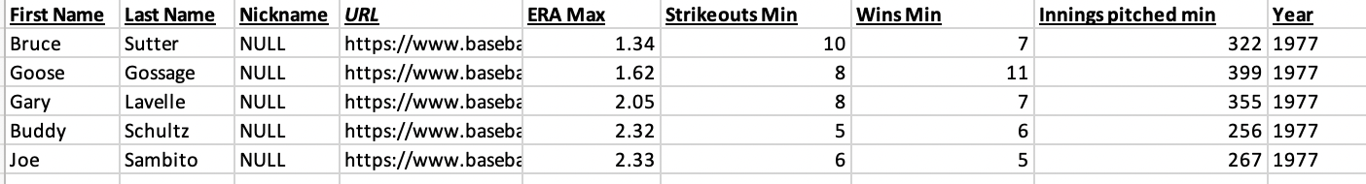
Stored Procedure development based on Use Case #2
The stored procedure receives input values from the user interface, which are used to set the variables of the procedure. The procedure then retrieves all values that satisfy the specified criteria and returns them. The below SQL simulates the UI’s rows being inserted into the table.
exec p_get_pitcher_stats
@year = 1977
,@max_era = 3
,@min_strk_out = 3
,@min_wins = 5
,@min_inns_pitched = 100

Slide 35
Stored Procedure development based on Use Case #3
USE CASE 3: Returns fielder statistics based on selection criteria
The user interface below accepts user input for fielder stats and has a drop down for years

Slide 36
Stored Procedure development based on Use Case #3
SQL code for stored procedure p_get_fielder_stats:
1. Up/down SQL
drop procedure if exists p_get_fielder_stats
GO
2. Pitcher’s Stats Procedure
create procedure p_get_fielder_stats
@year int = NULL,@min_batting_avg float = null,@min_hr int = null,@min_hits int = null,@min_obp float = null,@min_games_played int = null
AS BEGIN set nocount on
declare @row_count INT
select @row_count = COUNT(*)
from players AS p
INNER JOIN player_stats_by_year AS s ON p.player_id = s.players_player_id
WHERE s.stats_position != 'P'
AND (@year IS NULL OR s.stats_year = @year)
AND (@min_batting_avg IS NULL OR CAST(s.stats_hits AS FLOAT) / NULLIF(s.stats_at_bat, 0) >= @min_batting_avg)
AND (@min_hr IS NULL OR s.stats_home_runs >= @min_hr)
AND (@min_hits IS NULL OR s.stats_hits >= @min_hits)
AND (@min_obp IS NULL OR CAST(s.stats_hits + s.stats_base_on_balls +s.stats_intentional_walk + s.stats_hit_by_pitch AS FLOAT) /
NULLIF(s.stats_at_bat + s.stats_base_on_balls + s.stats_intentional_walk +s.stats_hit_by_pitch + s.stats_sac_flies, 0) >= @min_obp)
AND (@min_games_played IS NULL OR s.stats_games >= @min_games_played)
IF @row_count > 500
RAISERROR('More than 500 rows returned, please refine your search.', 16, 1)
SELECT
p.player_firstname, p.player_lastname, p.player_nickname, p.player_url,
ROUND(CAST(s.stats_hits AS FLOAT) / NULLIF(s.stats_at_bat, 0), 4) AS batting_avg,s.stats_home_runs, s.stats_hits,
ROUND(CAST(s.stats_hits + s.stats_base_on_balls + s.stats_intentional_walk +s.stats_hit_by_pitch AS FLOAT) /
NULLIF(s.stats_at_bat + s.stats_base_on_balls + s.stats_intentional_walk +s.stats_hit_by_pitch + s.stats_sac_flies, 0), 4) AS on_base_perc,s.stats_games, s.stats_year
FROM players AS p
INNER JOIN player_stats_by_year AS s ON p.player_id = s.players_player_id
WHERE s.stats_position != 'P'
AND (@year IS NULL OR s.stats_year = @year)
AND (@min_batting_avg IS NULL OR CAST(s.stats_hits AS FLOAT) / NULLIF(s.stats_at_bat, 0) >= @min_batting_avg)
AND (@min_hr IS NULL OR s.stats_home_runs >= @min_hr)
AND (@min_hits IS NULL OR s.stats_hits >= @min_hits)
AND (@min_obp IS NULL OR CAST(s.stats_hits + s.stats_base_on_balls +s.stats_intentional_walk + s.stats_hit_by_pitch AS FLOAT) /
NULLIF(s.stats_at_bat + s.stats_base_on_balls + s.stats_intentional_walk +s.stats_hit_by_pitch + s.stats_sac_flies, 0) >= @min_obp)
AND (@min_games_played IS NULL OR s.stats_games >= @min_games_played)
END GO

Slide 37
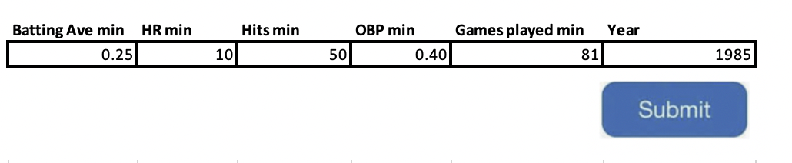
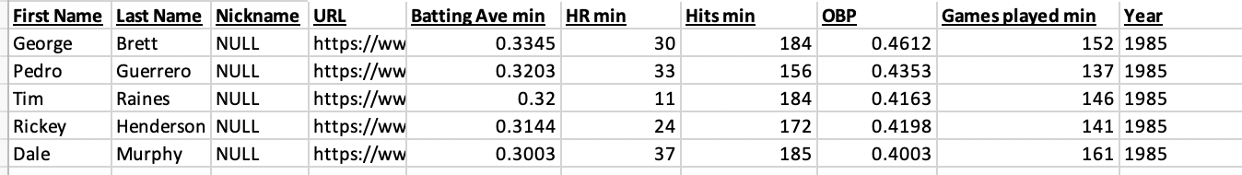
Stored Procedure development based on Use Case #3
The stored procedure receives input values from the user interface, which are used to set the variables of the procedure. The procedure then retrieves all values that satisfy the specified criteria and returns them. The below SQL simulates the UI’s rows being inserted into the table.
exec p_get_fielder_stats
@year = 1985
,@min_batting_avg = 0.25
,@min_hr = 10
,@min_hits = 50
,@min_obp = 0.40
,@min_games_played = 81

Slide 38
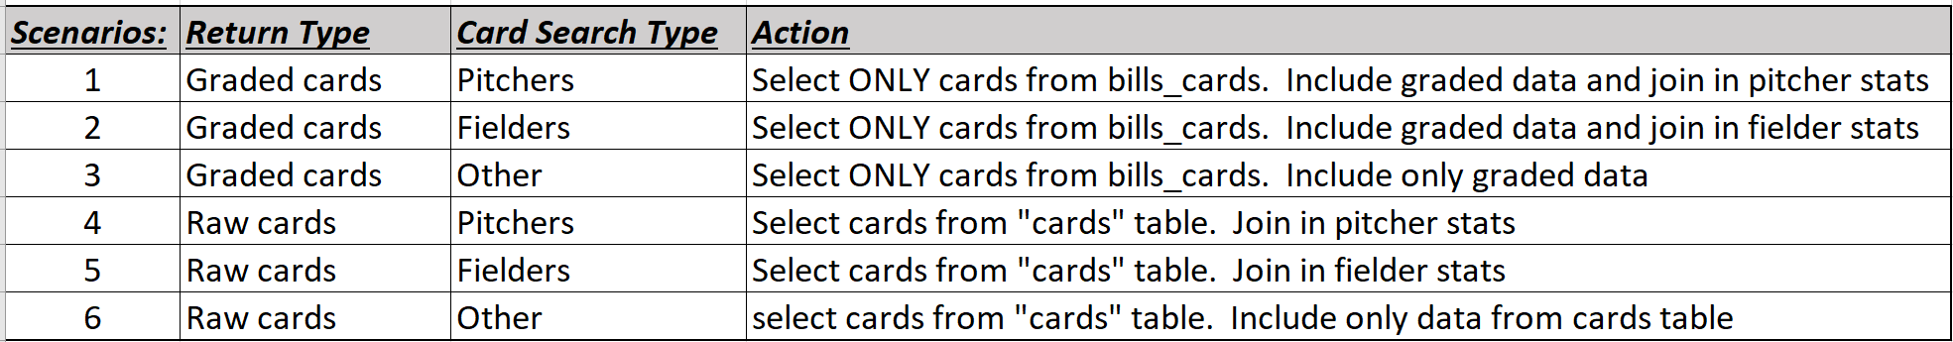
Stored Procedure development based on Use Case #4
USE CASE 4: Returns raw or graded cards based on selection criteria with player statistics (if applicable)
The user interface below permits selections in drop-down-list boxes 1 of 6 use case scenarios

Slide 39
Stored Procedure development based on Use Case #4
Use Case 4 was solved via 3 stored procedures:
p_card_select_pitchers will return cards (graded or raw as per user choice) based on the selection string from the UI along with key pitcher statistics.
p_card_select_fielders will return cards (graded or raw as per user choice) based on the selection string from the UI along with key fielder statistics.
P_card_select_other will return cards (graded or raw as per user choice) based on the selection string from the UI. “Other” implies that these cards are non-player cards thus no player statistics are returned.
SQL – down code:
-- USE CASE #4 - Card Select - 6 scenarios addressed
/*
Scenarios: Return Type Card Search Type Action
1 Graded cards Pitchers Select ONLY cards from bills_cards. Include graded data and join in pitcher stats
2 Graded cards Fielders Select ONLY cards from bills_cards. Include graded data and join in fielder stats
3 Graded cards Other Select ONLY cards from bills_cards. Include only graded data
4 Raw cards Pitchers Select cards from "cards" table. Join in pitcher stats
5 Raw cards Fielders Select cards from "cards" table. Join in fielder stats
6 Raw cards Other select cards from "cards" table. Include only data from that table.
*/
drop procedure if exists p_card_select_pitchers
drop procedure if exists p_card_select_fielders
drop procedure if exists p_card_select_other

Slide 40
Stored Procedure development based on Use Case #4
SQL code for stored procedure p_card_select_pitchers:
GO
Create procedure p_card_select_pitchers
@card_type char(6), --raw or graded
@search_str nvarchar(100), -- serach string
@year char(4) --specific year or 'all' for all years
AS
IF @year = 'all' --for all years
BEGIN
IF @card_type='raw' --raw cards
BEGIN
select c.card_desc,c.card_year,c.card_num,c.card_stat_year,c.card_notes --from cards
,p.stats_wins,p.stats_losses,p.stats_era--key stats for pitchers
,t.team_city,t.team_name,t.team_league --team information by year
from cards c
join player_stats_by_year p on c.card_player_id=p.players_player_id
join teams t on t.team_code=p.team_id
where c.card_desc like @search_str and c.card_stat_year=p.stats_year order by c.card_year
END
ELSE --graded cards
BEGIN
select c.bills_card_psa_desc,c.bills_card_cert,c.bills_card_num,c.bills_card_year,c.bills_card_grade,c.bills_card_pop,c.bills_card_pop_higher --from bills_cards
,p.stats_wins,p.stats_losses,p.stats_era--key stats for pitchers
from bills_cards c
join player_stats_by_year p on c.bills_card_player_id=p.players_player_id
join teams t on t.team_code=p.team_id
where c.bills_card_psa_desc like @search_str and c.bills_card_stat_year=p.stats_year order by c.bills_card_year
END
END
ELSE --for a specific year
BEGIN
IF @card_type='raw' --for raw cards
BEGIN
select c.card_desc,c.card_year,c.card_num,c.card_stat_year,c.card_notes --from cards
,p.stats_wins,p.stats_losses,p.stats_era--key stats for pitchers
,t.team_city,t.team_name,t.team_league --team information by year
from cards c
join player_stats_by_year p on c.card_player_id=p.players_player_id
join teams t on t.team_code=p.team_id
where c.card_desc like @search_str and c.card_year like @year and c.card_stat_year=p.stats_year order by c.card_year
END
ELSE --for graded cards
BEGIN
select c.bills_card_psa_desc,c.bills_card_cert,c.bills_card_num,c.bills_card_year,c.bills_card_grade,c.bills_card_pop,c.bills_card_pop_higher --from bills_cards
,p.stats_wins,p.stats_losses,p.stats_era--key stats for pitchers
from bills_cards c
join player_stats_by_year p on c.bills_card_player_id=p.players_player_id
join teams t on t.team_code=p.team_id
where c.bills_card_psa_desc like @search_str and c.bills_card_year like @year and c.bills_card_stat_year=p.stats_year order by c.bills_card_year
END
END

Slide 41
Stored Procedure development based on Use Case #4
SQL code for stored procedure p_card_select_fielders:
GO
Create procedure p_card_select_fielders
@card_type char(6), --raw or graded
@search_str nvarchar(100), -- serach string
@year char(4) --specific year or 'all' for all years
AS
IF @year = 'all' --for all years
BEGIN
IF @card_type='raw' --raw cards
BEGIN
select c.card_desc,c.card_year,c.card_num,c.card_stat_year,c.card_notes --from cards
,p.stats_position,p.stats_batting_avg,p.stats_on_base_perc,p.stats_at_bat,p.stats_hits--key stats for fielders
,p.stats_doubles,p.stats_triples,p.stats_home_runs,p.stats_rbi--key stats for fielders (continued)
,t.team_city,t.team_name,t.team_league --team information by year
from cards c
join player_stats_by_year p on c.card_player_id=p.players_player_id
join teams t on t.team_code=p.team_id
where c.card_desc like @search_str and c.card_stat_year=p.stats_year order by c.card_year
END
ELSE --graded cards
BEGIN
select c.bills_card_psa_desc,c.bills_card_cert,c.bills_card_num,c.bills_card_year,c.bills_card_grade,c.bills_card_pop,c.bills_card_pop_higher --from bills_cards
,p.stats_position,p.stats_batting_avg,p.stats_on_base_perc,p.stats_at_bat,p.stats_hits--key stats for fielders
,p.stats_doubles,p.stats_triples,p.stats_home_runs,p.stats_rbi--key stats for fielders (continued)
,t.team_city,t.team_name,t.team_league --team information by year
from bills_cards c
join player_stats_by_year p on c.bills_card_player_id=p.players_player_id
join teams t on t.team_code=p.team_id
where c.bills_card_psa_desc like @search_str and c.bills_card_stat_year=p.stats_year order by c.bills_card_year
END
END
ELSE --for a specific year
BEGIN
IF @card_type='raw' --for raw cards
BEGIN
select c.card_desc,c.card_year,c.card_num,c.card_stat_year,c.card_notes --from cards
,p.stats_position,p.stats_batting_avg,p.stats_on_base_perc,p.stats_at_bat,p.stats_hits--key stats for fielders
,p.stats_doubles,p.stats_triples,p.stats_home_runs,p.stats_rbi--key stats for fielders (continued)
,t.team_city,t.team_name,t.team_league --team information by year
from cards c
join player_stats_by_year p on c.card_player_id=p.players_player_id
join teams t on t.team_code=p.team_id
where c.card_desc like @search_str and c.card_year like @year and c.card_stat_year=p.stats_year order by c.card_year
END
ELSE --for graded cards
BEGIN
select c.bills_card_psa_desc,c.bills_card_cert,c.bills_card_num,c.bills_card_year,c.bills_card_grade,c.bills_card_pop,c.bills_card_pop_higher --from bills_cards
,p.stats_position,p.stats_batting_avg,p.stats_on_base_perc,p.stats_at_bat,p.stats_hits--key stats for fielders
,p.stats_doubles,p.stats_triples,p.stats_home_runs,p.stats_rbi--key stats for fielders (continued)
,t.team_city,t.team_name,t.team_league --team information by year
from bills_cards c
join player_stats_by_year p on c.bills_card_player_id=p.players_player_id
join teams t on t.team_code=p.team_id
where c.bills_card_psa_desc like @search_str and c.bills_card_year like @year and c.bills_card_stat_year=p.stats_year order by c.bills_card_year
END
END

Slide 42
Stored Procedure development based on Use Case #4
SQL code for stored procedure p_card_select_other (non-player search):
GO
Create procedure p_card_select_other
@card_type char(6), --raw or graded
@search_str nvarchar(100), -- serach string
@year char(4) --specific year or 'all' for all years
AS
IF @year = 'all' --for all years
BEGIN
IF @card_type='raw' --raw cards
BEGIN
select c.card_desc,c.card_year,c.card_num,c.card_notes --from cards
from cards c
where c.card_desc like @search_str and c.card_player_id is null order by c.card_year
END
ELSE --graded cards
BEGIN
select c.bills_card_psa_desc,c.bills_card_cert,c.bills_card_num,c.bills_card_year,c.bills_card_grade,c.bills_card_pop,c.bills_card_pop_higher
from bills_cards c
where c.bills_card_psa_desc like @search_str and c.bills_card_player_id is null order by c.bills_card_year
END
END
ELSE --for a specific year
BEGIN
IF @card_type='raw' --for raw cards
BEGIN
select c.card_desc,c.card_year,c.card_num,c.card_notes --from cards
from cards c
where c.card_desc like @search_str and c.card_year like @year and c.card_player_id is null
END
ELSE --for graded cards
BEGIN
select c.bills_card_psa_desc,c.bills_card_cert,c.bills_card_num,c.bills_card_year,c.bills_card_grade,c.bills_card_pop,c.bills_card_pop_higher
from bills_cards c
where c.bills_card_psa_desc like @search_str and c.bills_card_year like @year and c.bills_card_player_id is null
END
END

Slide 43
Stored Procedure development based on Use Case #4
When the UI sends in the search type (pitchers, fielders, other) the SQL code below determines which stored procedure to call. Based on the other parameters from the UI, (card type, year, search string) the stored procedure returns the appropriate data.
SQL code to retrieve data with simulation parameters:
GO
declare @card_search_type char(8) -- 3 options from application 'pitchers', 'fielders','other'
set @card_search_type='fielders' --simulating as a variable sent from the User interface
IF @card_search_type='pitchers'--simulating inputs as variables from the user interface
BEGIN
EXEC p_card_select_pitchers
@card_type=‘graded',
@search_str='nol% rya%',
@year='all'
END
ELSE IF @card_search_type='fielders'
BEGIN
EXEC p_card_select_fielders
@card_type='raw',
@search_str='regg% jack%',
@year='all'
END
ELSE
BEGIN
EXEC p_card_select_other
@card_type='raw',
@search_str='worl% ser%',
@year='all'
END

Slide 44
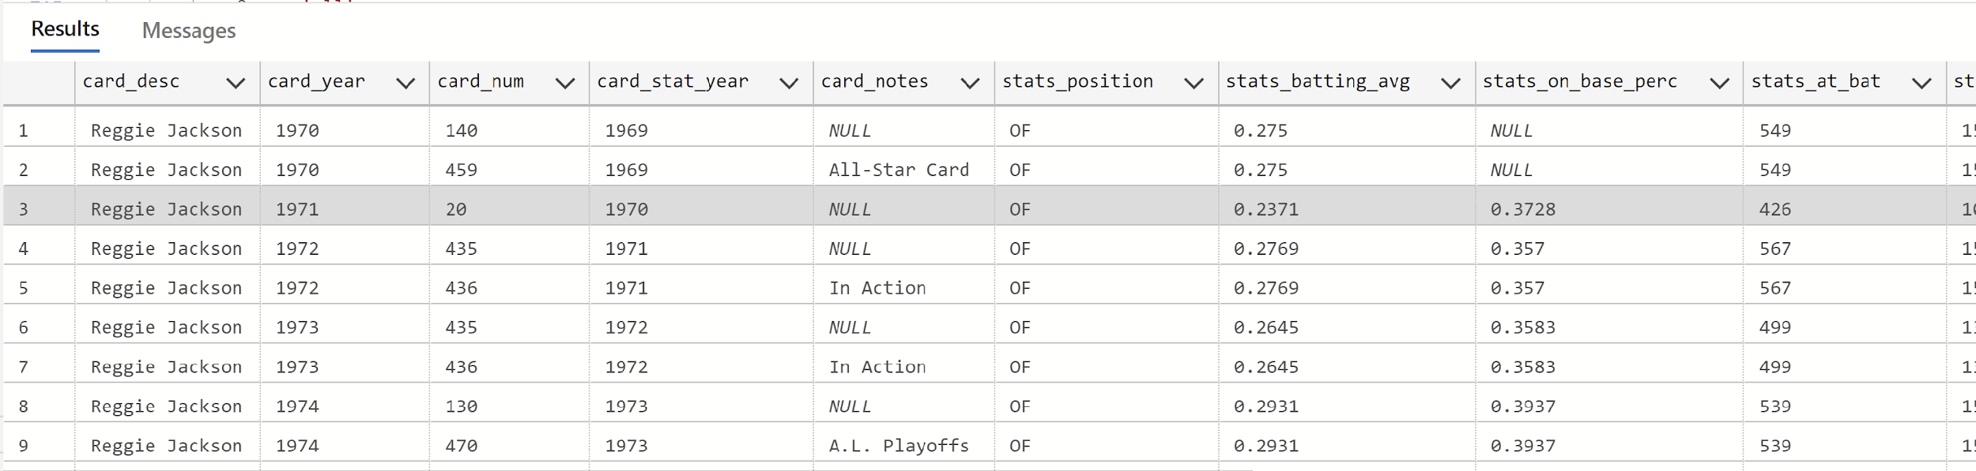
Stored Procedure development based on Use Case #4
When the UI sends in the search type (pitchers, fielders, other) the SQL code below determines which stored procedure to call. Based on the other parameters from the UI, (card type, year, search string) the stored procedure returns the appropriate data.
Subset of results from the simulation given the parameters sent from the UI:
ELSE IF @card_search_type='fielders'
BEGIN
EXEC p_card_select_fielders
@card_type='raw',
@search_str='regg% jack%',
@year='all'
Matches search string from the UI.
The year the card is issued (e.g. 1971) actually reflects the players performance for the previous year. For card year 1971, stats are pulled for the year 1970.
Position of Reggie Jackson “OF” (out fielder)
Key statistics by year for a fielder

Slide 45
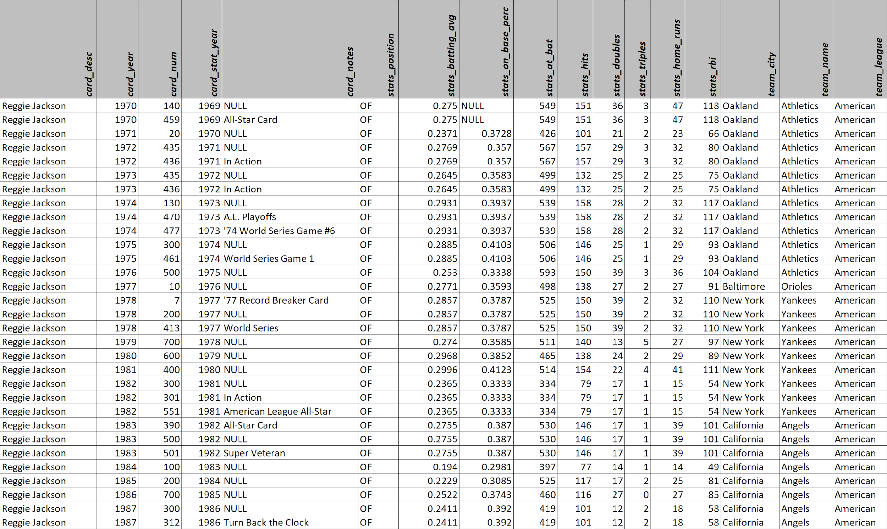
The full return from the query on the previous page (table cards, player_stats_by_year, and teams are joined):

Slide 46
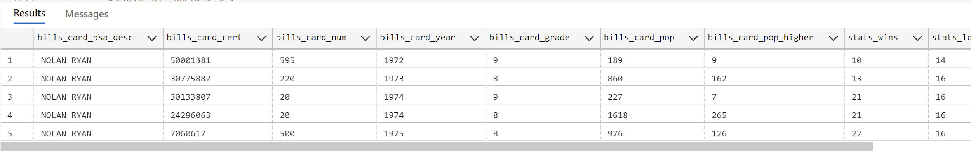
Stored Procedure development based on Use Case #4
When the UI sends in the search type (pitchers, fielders, other) the SQL code below determines which stored procedure to call. Based on the other parameters from the UI, (card type, year, search string) the stored procedure returns the appropriate data.
Subset of results from the simulation given the parameters sent from the UI:
IF @card_search_type='pitchers'
BEGIN
EXEC p_card_select_pitchers
@card_type='graded',
@search_str='nol% rya%',
@year='all'
END
Matches search string from the UI.
PSA certification number unique across ALL graded cards
PSA grade (1-10)
Population of cards at this grade
Population of cards at a higher grade
Key statistics by year for a pitcher

Slide 47
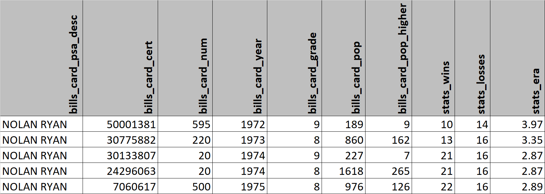
The full return from the query on the previous page (table cards, player_stats_by_year, and teams are joined):

Slide 48
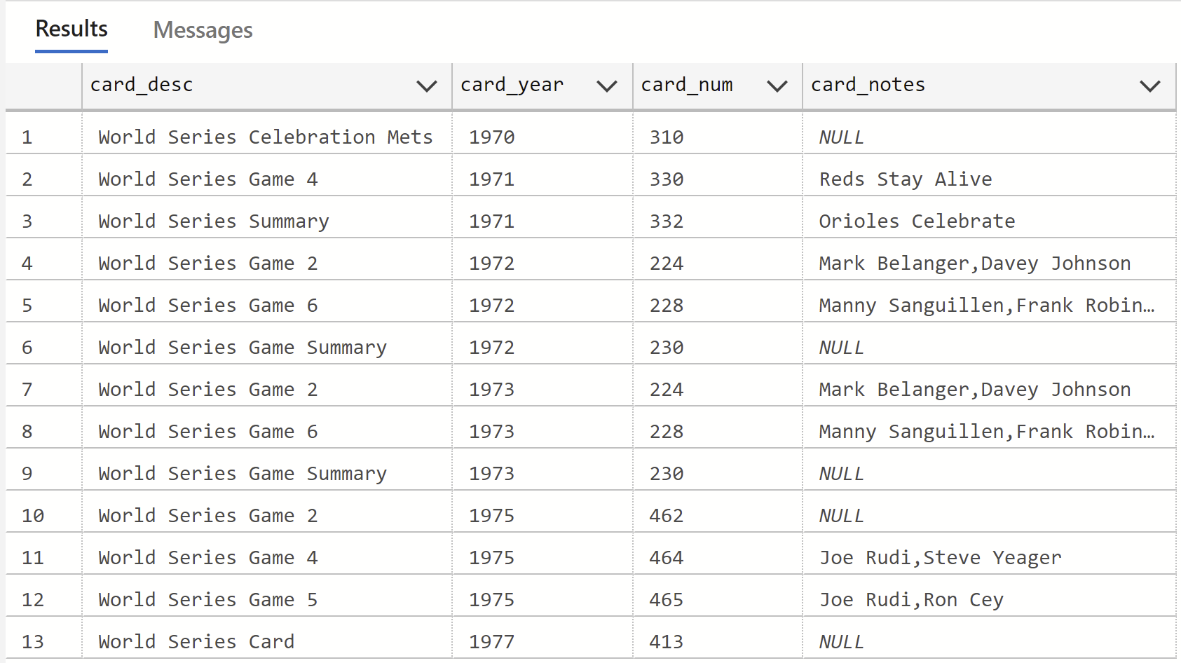
Stored Procedure development based on Use Case #4
When the UI sends in the search type (pitchers, fielders, other) the SQL code below determines which stored procedure to call. Based on the other parameters from the UI, (card type, year, search string) the stored procedure returns the appropriate data.
Full results from the simulation given the parameters sent from the UI:
ELSE
BEGIN
EXEC p_card_select_other
@card_type='raw',
@search_str='worl% ser%',
@year='all'
END
NOTE: There are no player statistics when searching for non-player (other) cards

Slide 49
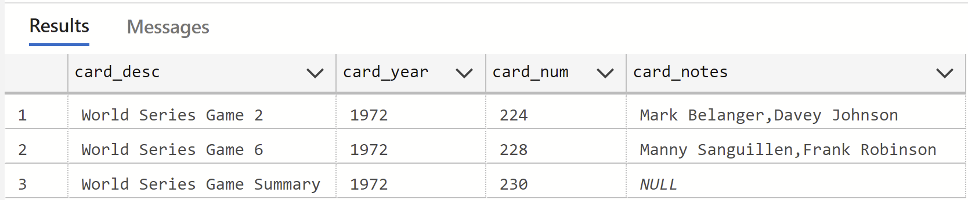
Stored Procedure development based on Use Case #4
When the UI sends in the search type (pitchers, fielders, other) the SQL code below determines which stored procedure to call. Based on the other parameters from the UI, (card type, year, search string) the stored procedure returns the appropriate data.
Same search as previous slide with a specific year selected (1972)
ELSE
BEGIN
EXEC p_card_select_other
@card_type='raw',
@search_str='worl% ser%',
@year=‘1972'
END

Slide 50
Stored Procedure development based on Use Case #5
USE CASE 5: Allow inserts and/or updates to the graded cards table as graded cards are collected.
The user interface below will allow up to 10 entries to be added and/or updated into the graded cards table

Slide 51
Stored Procedure development based on Use Case #5
A table variable is created below (1). The SP (2) inserts/updates based on the table information sent from the UI.
1. Up/down SQL
2. Upsert Procedure
--USE CASE 5 - Upsert into Bills_cards
-- up/down
GO
drop procedure if exists p_upsert_bills_cards
drop type if exists bills_upsert_type
--up
-- creating temp table bills_upsert_type to field multi row inputs
GO
CREATE TYPE bills_upsert_type AS TABLE
(card_cert INT,
card_spec INT,
card_num INT,
card_year INT,
card_psa_desc nvarchar(100),
card_grade float,
card_pop int,
card_pop_higher int,
card_stat_year int,
card_player_id int
)
GO
CREATE PROCEDURE p_upsert_bills_cards
@var_bills_upserts
bills_upsert_type READONLY
AS
BEGIN
SET NOCOUNT ON
MERGE INTO bills_cards AS target
USING (SELECT card_cert, card_spec, card_num, card_year, card_psa_desc, card_grade, card_pop,
card_pop_higher, card_stat_year, card_player_id
FROM @var_bills_upserts
) AS source (card_cert, card_spec, card_num, card_year, card_psa_desc, card_grade, card_pop,
card_pop_higher, card_stat_year, card_player_id)
ON (target.bills_card_cert = source.card_cert)
WHEN MATCHED THEN
UPDATE SET
bills_card_spec = source.card_spec,
bills_card_num = source.card_num,
bills_card_year = source.card_year,
bills_card_psa_desc = source.card_psa_desc,
bills_card_grade = source.card_grade,
bills_card_pop = source.card_pop,
bills_card_pop_higher = source.card_pop_higher,
bills_card_stat_year = source.card_stat_year,
bills_card_player_id = source.card_player_id
WHEN NOT MATCHED THEN
INSERT (bills_card_cert, bills_card_spec, bills_card_num, bills_card_year, bills_card_psa_desc, bills_card_grade, bills_card_pop, bills_card_pop_higher, bills_card_stat_year, bills_card_player_id)
VALUES (source.card_cert, source.card_spec, source.card_num, source.card_year, source.card_psa_desc, source.card_grade, source.card_pop, source.card_pop_higher, source.card_stat_year, source.card_player_id);
END

Slide 52
Stored Procedure development based on Use Case #5
The user interface passes its table into a table variable into which the rows are inserted. The upsert stored procedure is then executed. The below SQL simulates the UI’s rows being inserted into the table.
GO
-- declaring a table variable "var_upsert_bills_cards" with insert values that would come from the user interface
DECLARE @var_upsert_bills_cards AS bills_upsert_type
INSERT INTO @var_upsert_bills_cards (card_cert, card_spec, card_num, card_year, card_psa_desc, card_grade,
card_pop, card_pop_higher, card_stat_year, card_player_id)
VALUES (1234567890, 1234567890, 555, 1986, 'TESTING BILLS UPSERT', 9, 23, 6, 1985, 687)
INSERT INTO @var_upsert_bills_cards (card_cert, card_spec, card_num, card_year, card_psa_desc, card_grade,
card_pop, card_pop_higher, card_stat_year, card_player_id)
VALUES (1111111, 2222222, 666, 1986, 'TESTING BILLS UPSERT2', 8.5, 45, 10, 1985, 687)
-- executing my stored procedure (p_upsert_bills_cards) to affect the table bills_cards
EXEC p_upsert_bills_cards @var_upsert_bills_cards
select * from bills_cards where bills_card_cert=1234567890 or bills_card_cert=1111111

Slide 53
Stored Procedure development based on Use Case #5
If the user interface passes in values for an existing graded card, an update will be performed. Below the inserted cards from the previous example are updated with a different description.
GO
-- declaring a table variable "var_upsert_bills_cards" with update values that would come from the user interface
DECLARE @var_upsert_bills_cards AS bills_upsert_type
INSERT INTO @var_upsert_bills_cards (card_cert, card_spec, card_num, card_year, card_psa_desc, card_grade,
card_pop, card_pop_higher, card_stat_year, card_player_id)
VALUES (1234567890, 1234567890, 555, 1986, 'UPDATING 1ST TEST', 9, 23, 6, 1985, 687)
INSERT INTO @var_upsert_bills_cards (card_cert, card_spec, card_num, card_year, card_psa_desc, card_grade,
card_pop, card_pop_higher, card_stat_year, card_player_id)
VALUES (1111111, 2222222, 666, 1986, 'UPDATING 2ND TEST', 8.5, 45, 10, 1985, 687)
-- executing my stored procedure (p_upsert_bills_cards) to affect the table bills_cards
EXEC p_upsert_bills_cards @var_upsert_bills_cards
select * from bills_cards where bills_card_cert=1234567890 or bills_card_cert=1111111

Slide 54
Table Of Contents
Introduction and project approval
Conceptual and Logical data models
External data model and User Interface
Implementation: Table buildout and data migration
Implementation: Stored Procedure development based on Use Cases
Appendix
- Team Log of contributions
- Mapping of required artifacts from the syllabus

Slide 55
Team log of contributions
January:
1st | 2nd | 3rd | 4th –Formed project team via email. | 5th | 6th | 7th
8th | 9th | 10th | 11th | 12th | 13th | 14th
15th | 16th | 17th –Bill establishes group meeting routine. –Team sends Chad Harper email confirmation of group formation. | 18th | 19th | 20th | 21st
22nd | 23rd | 24th | 25th | 26th –Team meeting 5pm-6pm EST. | 27th | 28th
29th | 30th | 31st

Slide 56
Team log of contributions
February:
1st –Team finalizes project idea. | 2nd –Team meeting 5pm-6pm EST. | 3rd | 4th –Bill creates initial data model. | 5th –Team sends email to Chad with our project idea for discussion on 2/7. | 6th | 7th –Team gets idea approval and feedback from Chad Harper in class.
8th | 9th –Team meeting 5pm-6pm EST. –Ryan creates Github repository and server. | 10th | 11th | 12th | 13th | 14th
15th | 16th –Team finalizes dataset for the project. | 17th | 18th | 19th | 20th | 21st
22nd | 23rd –Team meeting 5pm-6pm EST. | 24th | 25th | 26th | 27th | 28th –Andrew finds data import method via Azure.

Slide 57
Team log of contributions
March:
1st | 2nd | 3rd –Team meeting 5pm-6pm EST. | 4th | 5th | 6th | 7th –Ryan creates logical and conceptual data models. –Ryan creates conceptual cardinality document.
8th –Ryan creates custom Python data import scripts. | 9th | 10th –Team meeting 5pm-6pm EST. | 11th | 12th –Bill creates cards table. –Bill creates stored procedure use cases document. | 13th | 14th –Bill creates bills_cards and players tables. –Ryan contributes strongly to the creation of the players table.
15th | 16th –Team meeting 5pm-6pm EST. –Andrew cleans multiple csv files for importation. –Andrew creates stored procedure 1. | 17th –Bill creates teams table. | 18th –Andrew creates player_stats_by_year table. –Ryan contributes strongly to the data integrity of the player_stats_by_year table. | 19th –Team meeting 5pm-6pm EST. | 20th | 21st
22nd –Team meeting 5pm-6pm EST. –Bill creates stored procedure 5. | 23rd –Bill creates stored procedure 4. –Ryan contributes strongly to the function of stored procedure 4. | 24th –Bill creates presentation deck. | 25th –Bill imports work into presentation deck. | 26th | 27th –Andrew imports work and contribution log into presentation deck. –Ryan imports work into presentation deck. –Final deck review 5pm-6pm EST. | 28th –Video recordings 4pm-5:30pm EST.

Slide 58
Mapping of Required Artifacts from the Syllabus
Agenda Reference | Artifacts listed from the syllabus
Complete a team project, which demonstrates your ability to work in a team to design and implement a functional system with a database, based on what you have learned in the course. Guidelines for this are:
Title Page | o Work in self-assembled teams of two to three students.
Introduction and project approval | o Devise your own database to design and implement.
Introduction and project approval | o The project idea must be preapproved, prior to beginning work.
Required artifacts for team project submission are as follows:
Introduction and project approval | 1. Document with team name, group members, and which project you will work on. If the project is your own idea, a requirements document must be submitted and approved.
Conceptual and Logical data models | 2. Data analysis of the facts listing entities, attributes, and relationships in the data model.
Conceptual and Logical data models | 3. Conceptual data model diagram.
Conceptual and Logical data models | 4. Logical data model diagram.
External data model and user interface | 5. Identification of your external data model and data logic.
External data model and user interface | 6. Basic layout of all application screens.
External data model and user interface | 7. Diagram of each screen used in the application.
Implementation: Table build out and data migration | 8. SQL up/down script to implement the internal model with initial data.
Implementation: Table build out and data migration | 9. SQL up/down Script to load/migrate in existing data.
Implementation: SP development based on Use Cases | 10. SQL up/down script of data logic for the external data model.
Implementation: SP development based on Use Cases | 11. Implementation of the application itself.
Appendix | 12. A team log recording individual and group contributions to the project, including when and by whom.
This Deliverable | 13. A slide deck of your presentation.
Separately submitted | 14. A video recording of your team presentation.
Separately submitted | 15. A video reflection of what you learned from the experience, what you would do better if you had the time, etc.

